Slide 1

Software Engineering Summit
Android Workshop
Instructor: Yashar Atajan
TA: Nick Capurso

Slide 2







About Yashar
Yashar Atajan @yaxarat
Undergrad - Virginia Commonwealth University (VCU)
Software Engineer working on Android SDKs.

Slide 3






About Nick
Nick Capurso @nickcapurso
Undergrad - Texas Christian Univ (TCU) Grad - George Washington Univ (GWU) I also teach Android at GWU! Capital One Wallet, Capital One Mobile, SDKs
Came in through the intern & TDP programs :)

Slide 4
Before we get started...
We’ll be using this GitHub repo as a base.
The workshop assumes you completed the pre-reqs and have a working Android development environment.
Ability to run the app on the Android emulator or a physical device.
Import the “Start” folder into Android Studio and run it on an emulator / device.

Slide 5
If you need help...
Short questions:
Use the “Raise Hand” action in Zoom. Or feel free to interrupt me!
You can also post short questions in the Zoom chat - we’ll be monitoring it!
Debugging help:
Post your issue in the #ses-may21help-xg Slack channel with any relevant code / screenshots.
During short breaks in the workshop, we will use Zoom breakout rooms for any in-depth debugging with screen share.
Slack: @yashar (Instructor), @nickcapurso (TA)
Step-by-step instructions:
Full text instructions for this workshop are available on GitHub.

Slide 6
Workshop

Slide 7
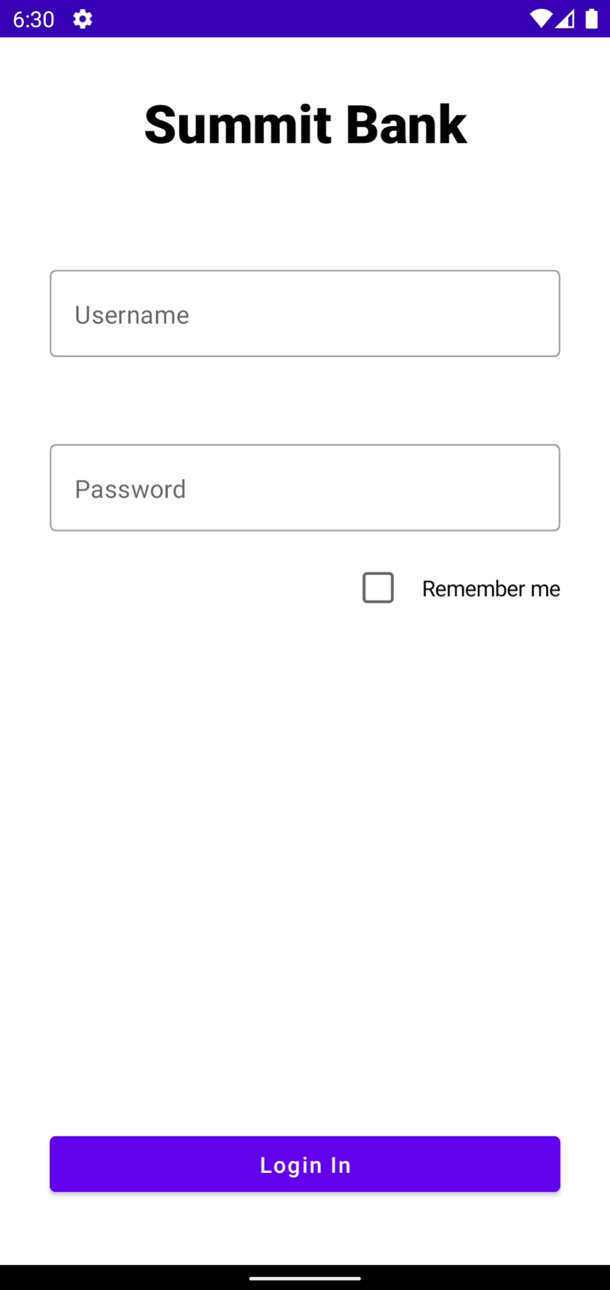
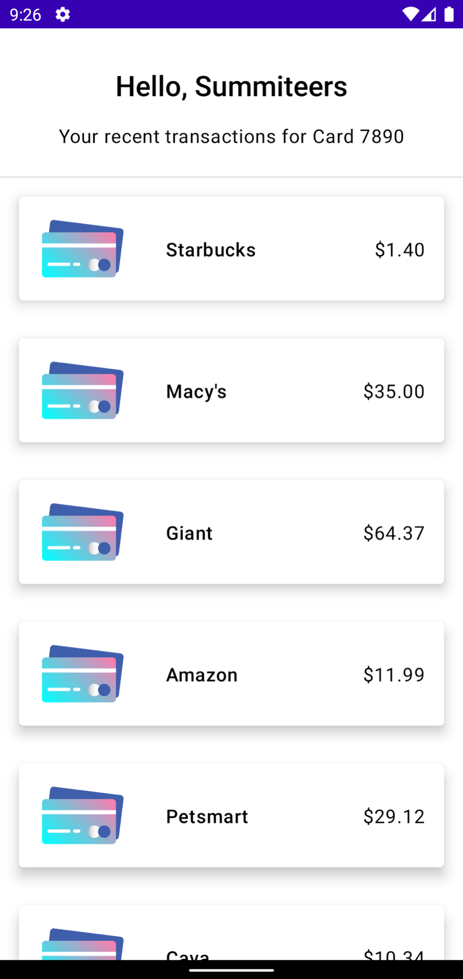
What’re we building?
A simple app that allows the user to login & view a list of recent transactions.

Slide 8
What’re we building?
Topics
UI Design
Launching new screens
Networking (mocked)
Rendering a list
Data storage

Slide 9
Android Studio
Two Android Studio configurations to make the workshop go more smoothly...

Slide 10
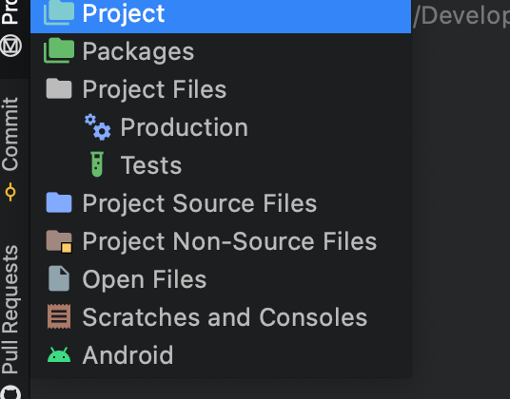
Android Studio
In the left-panel, switch to the “Android” view.
I prefer this view of the project files as I think it is more concise and easy to navigate.
Click Android if not pre-set.

Slide 11
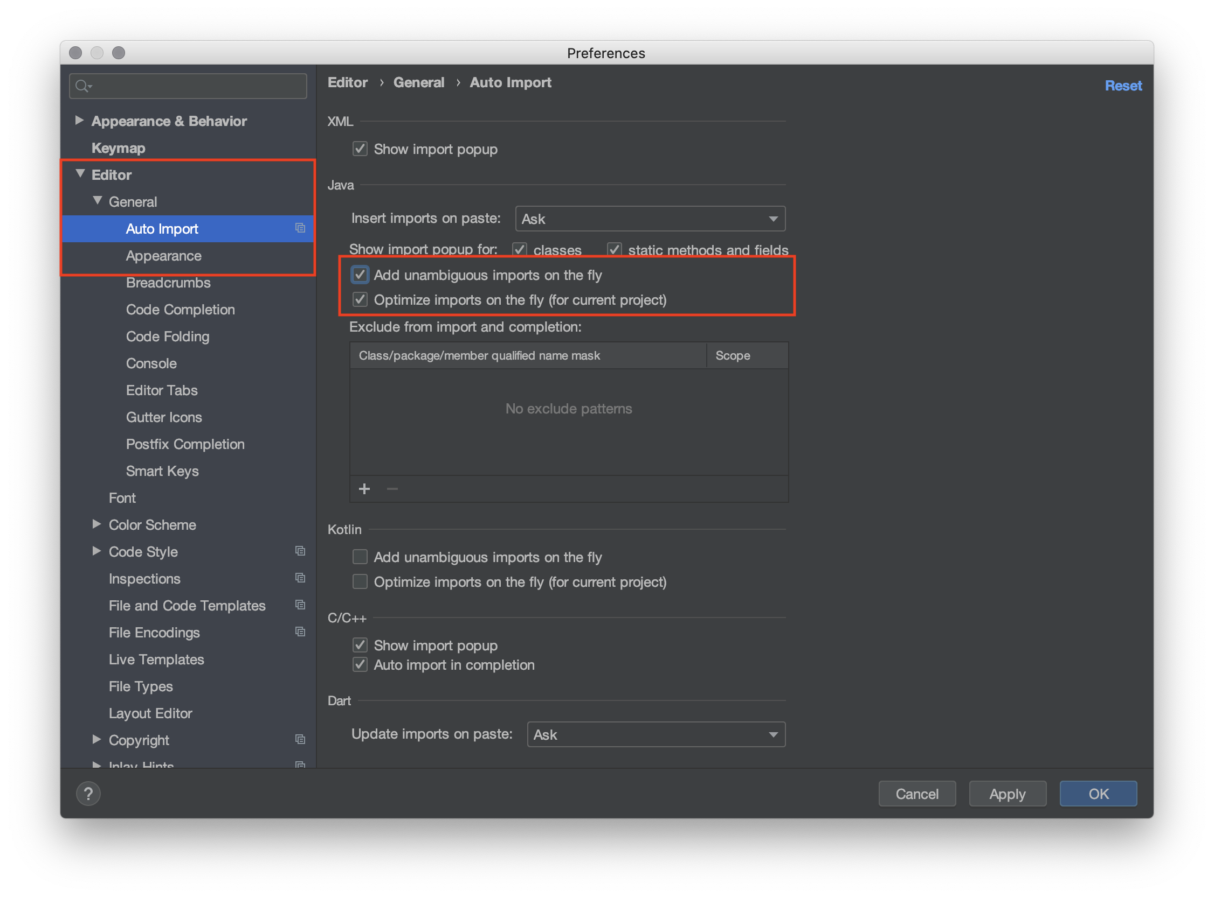
Android Studio
Open Settings / Preferences
(Windows) File → Settings
(OS X) Android Studio → Preferences
Turn on auto-imports!
Under: Editor → General → Auto Import
Enable “Add unambiguous imports…”
Enable “Optimize imports…”

Slide 12
Fragments
Apps are comprised of “Fragments” that live inside an “Activity”.
You can think of these as the individual screens.
Notes:
You can further break down into Fragments which is an encapsulation of UI + behaviors (but are less beginner-friendly)

Slide 13
Fragments
Two main components:
UI design
What does the UI look like.
UI behaviors
How does the UI react to user input.

Slide 14
UI Design

Slide 15
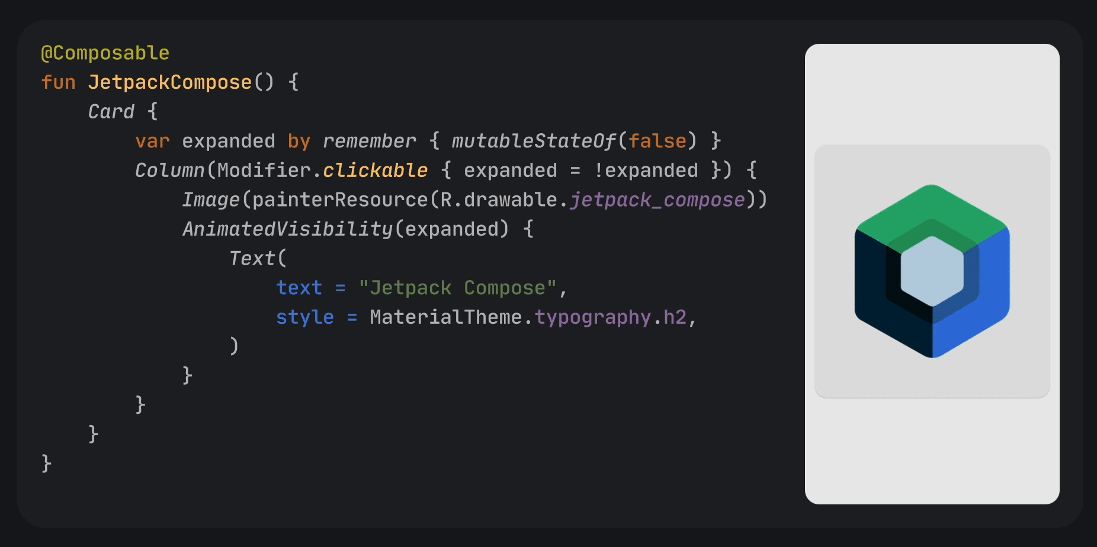
UI Design
UIs are built with a Jetpack Compose framework.

Slide 16
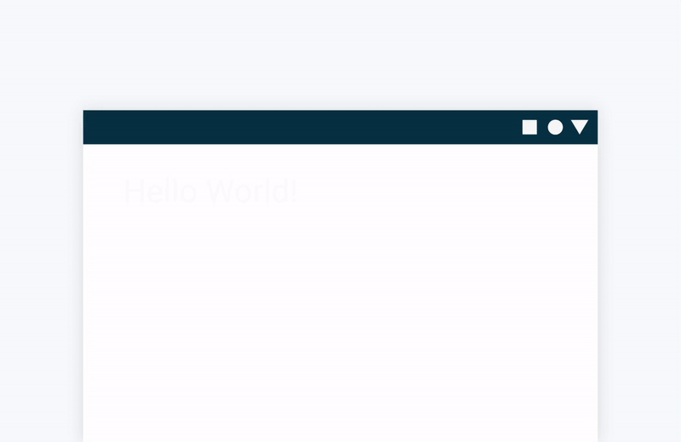
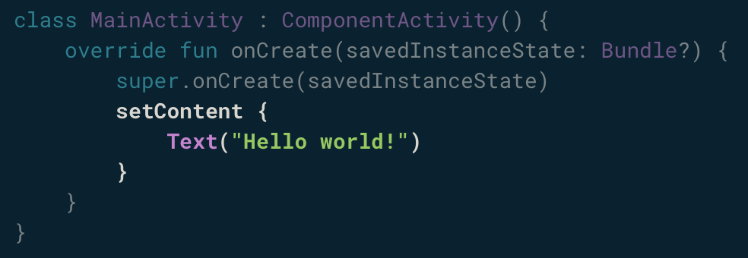
UI Design
Jetpack Compose is built around composable functions.
These functions let you define your app's UI programmatically.

Slide 17
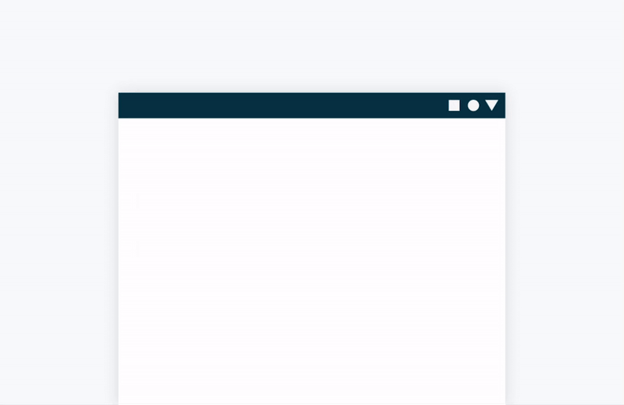
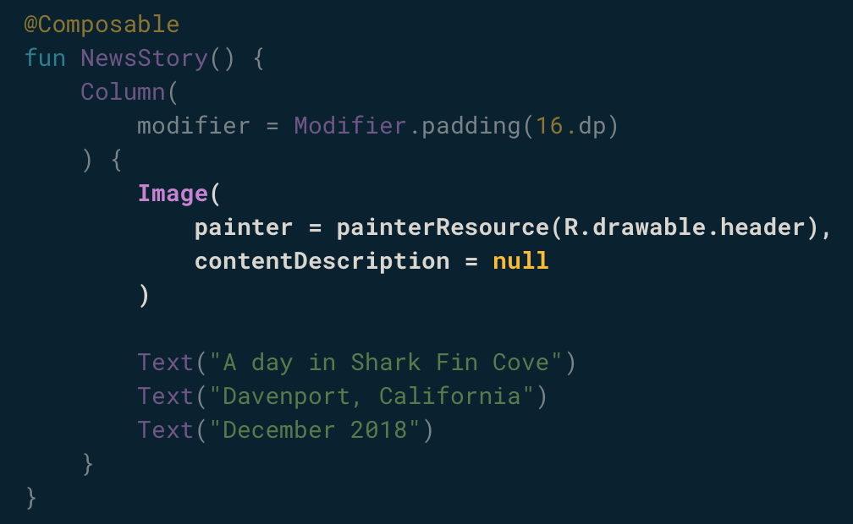
UI Design
UI elements are hierarchical, with elements contained in other elements.
You build a UI hierarchy by calling composable functions from other composable functions.

Slide 18
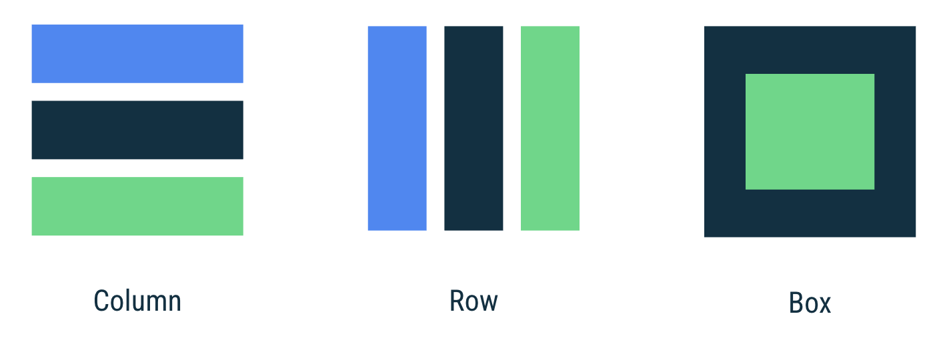
UI Layouts
Column: to place items vertically on the screen.
Row: to place items horizontally on the screen.
Box: to put one element on top of another.

Slide 19

UI Layouts
On Android, we don’t measure in pixels.
Two screens of the same size can have different densities.
Android provides “dp” or density-independent pixels as a measure.

Slide 20
UI Layouts
There’s also “sp” or scalable pixels, which are used with text.

Slide 21
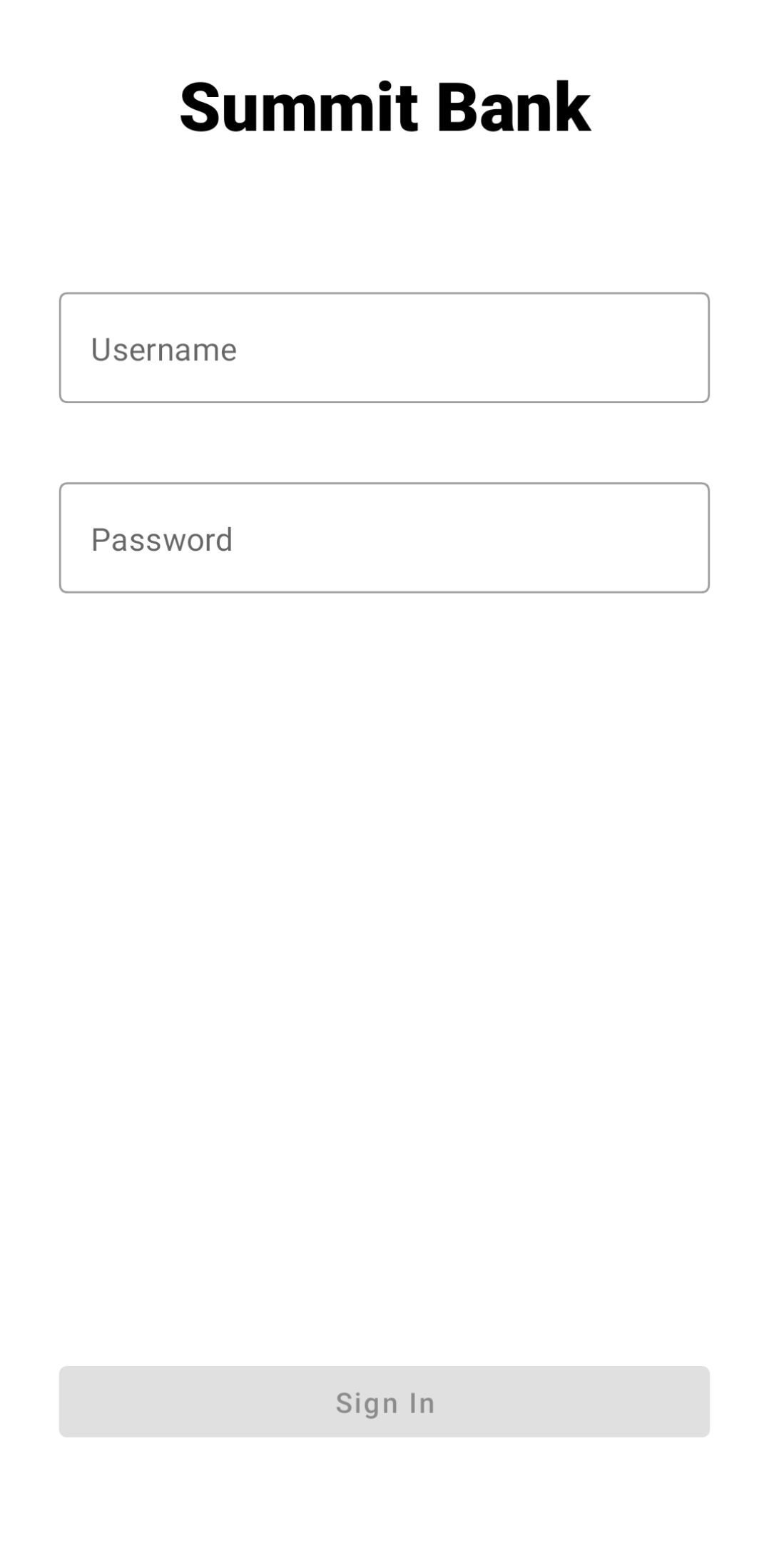
Login Screen UI
Let’s build a simple login form, without a “Remember Me” checkbox.

Slide 22
UI Behaviors

Slide 23
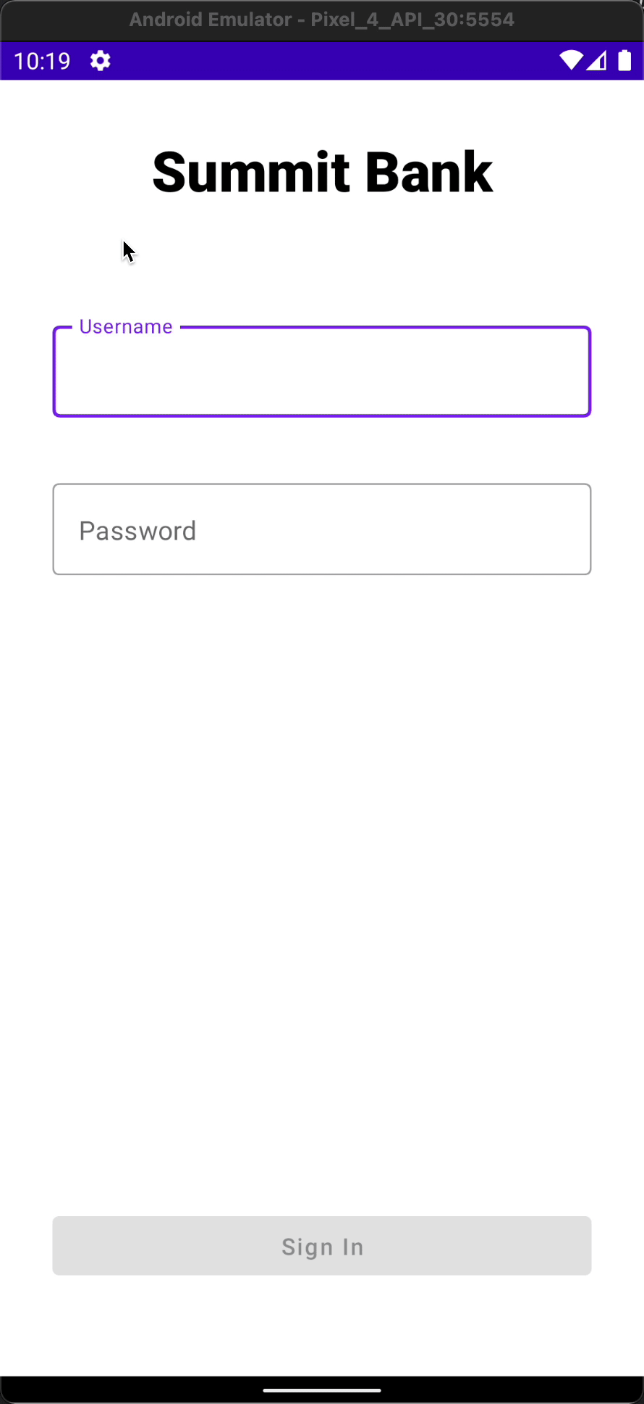
Login Screen Behaviors
Now we can actually write some code to add behaviors to the UI.
Disable the “Sign In” button unless text was inputted.
Show loading indicator while login

Slide 24
Login Screen Behaviors
Behaviors and logic for our UI are written Kotlin in an ViewModel class.

Slide 25
Login Screen Behaviors
Android apps use an “event-driven” programming style.
Rather than having a main() function and executing sequentially, we write code that responds to events.
e.g. when the screen loads, when the user performs some input, etc.

Slide 26
Login Screen Behaviors
As an Android developer, you may want to react when:
When the screen is created
When the user puts the app in the background
When a popup is obscuring your screen
etc.

Slide 27
Login Screen Behaviors
Android notifies your Activity and Fragment of these events via callbacks:
onCreate
onStart
onStop
etc.
This is called the “lifecycle”!

Slide 28
Networking

Slide 29
Networking
Usually, signing in involves making a network call.
Server will validate credentials and return user data.

Slide 30
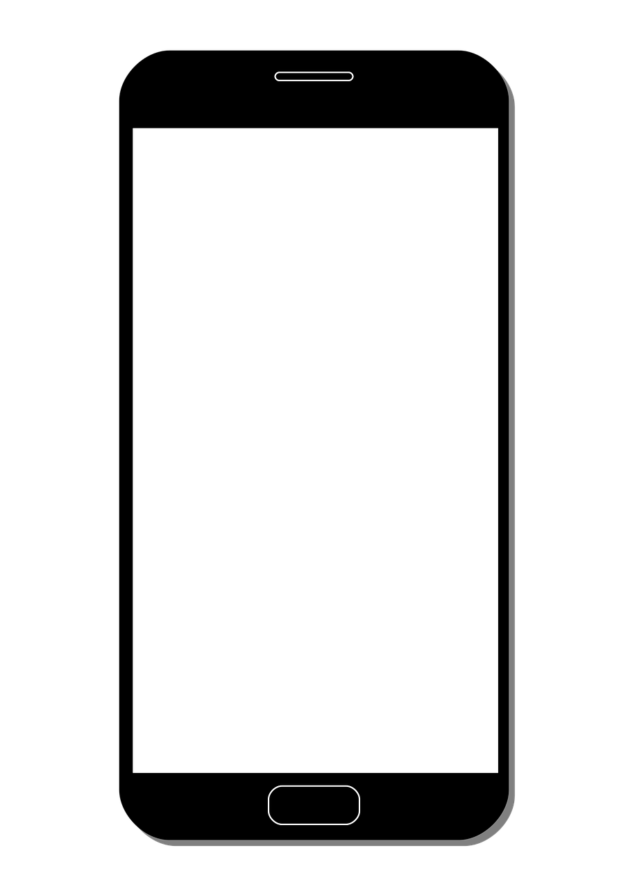

Networking
Usually, signing in involves making a network call.
Server will validate credentials and return user data.
username : summituser01 password : abc123

Slide 31
Networking
Usually, signing in involves making a network call.
Server will validate credentials and return user data.
name : John Summiteer card : x1234 transactions : [ “Starbucks $1.50” … “ ]

Slide 32
Networking
Networking can be a complex subject in Android.
Need to be on a background thread.
Handling connection errors.
Creating a network request.
Parsing a network response.

Slide 33
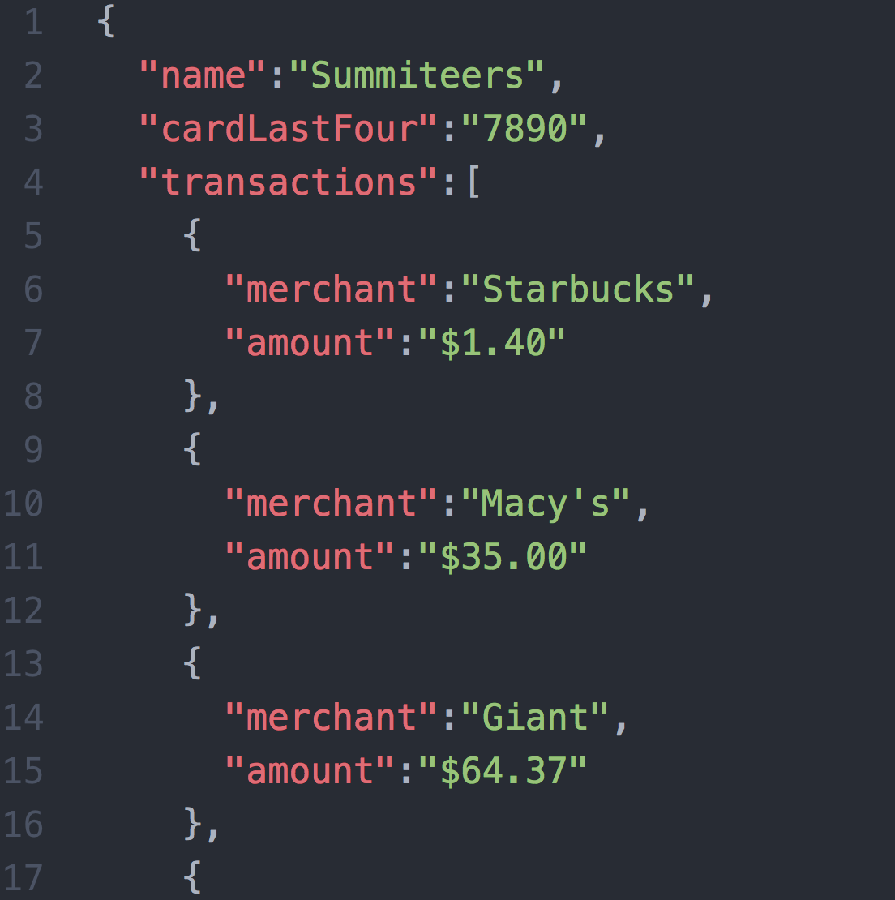
Networking
The server sends back data using some standardized format.
JavaScript Object Notation (JSON) is fairly common.
You’d also need to code to parse the data you need from the server response.

Slide 34
Networking
I’d recommend using a library here:
OkHttp
The “asynchronous” example here is good too.

Slide 35
Networking
For the purpose of the workshop let’s use a prebuilt “LoginService” class to retrieve user details after they click the “Sign In” button…
User’s name (“Summiteers”)
User’s card last 4 (“7890”)
List of transactions (“Starbucks $1.50, Amazon $32.10, …)

Slide 36
Second Fragment

Slide 37

We’ll display the user’s data on a separate Fragment called the “SummaryFragment”.
We need to create this new Fragment and launch it from our LoginFragment (passing it the data returned by the server).

Slide 38
Starting a second activity
On login success, we want to start the “SummaryFragment”
We also want to pass the user’s details to that fragment to display.

Slide 39
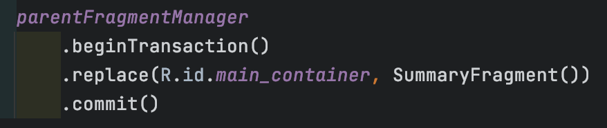
Fragment Transaction
New fragments are launched using “FragmentManager”.
With fragmentManager, you:
Specify which fragment should be launched
How the fragment should be launched
Where the fragment should be launched

Slide 40
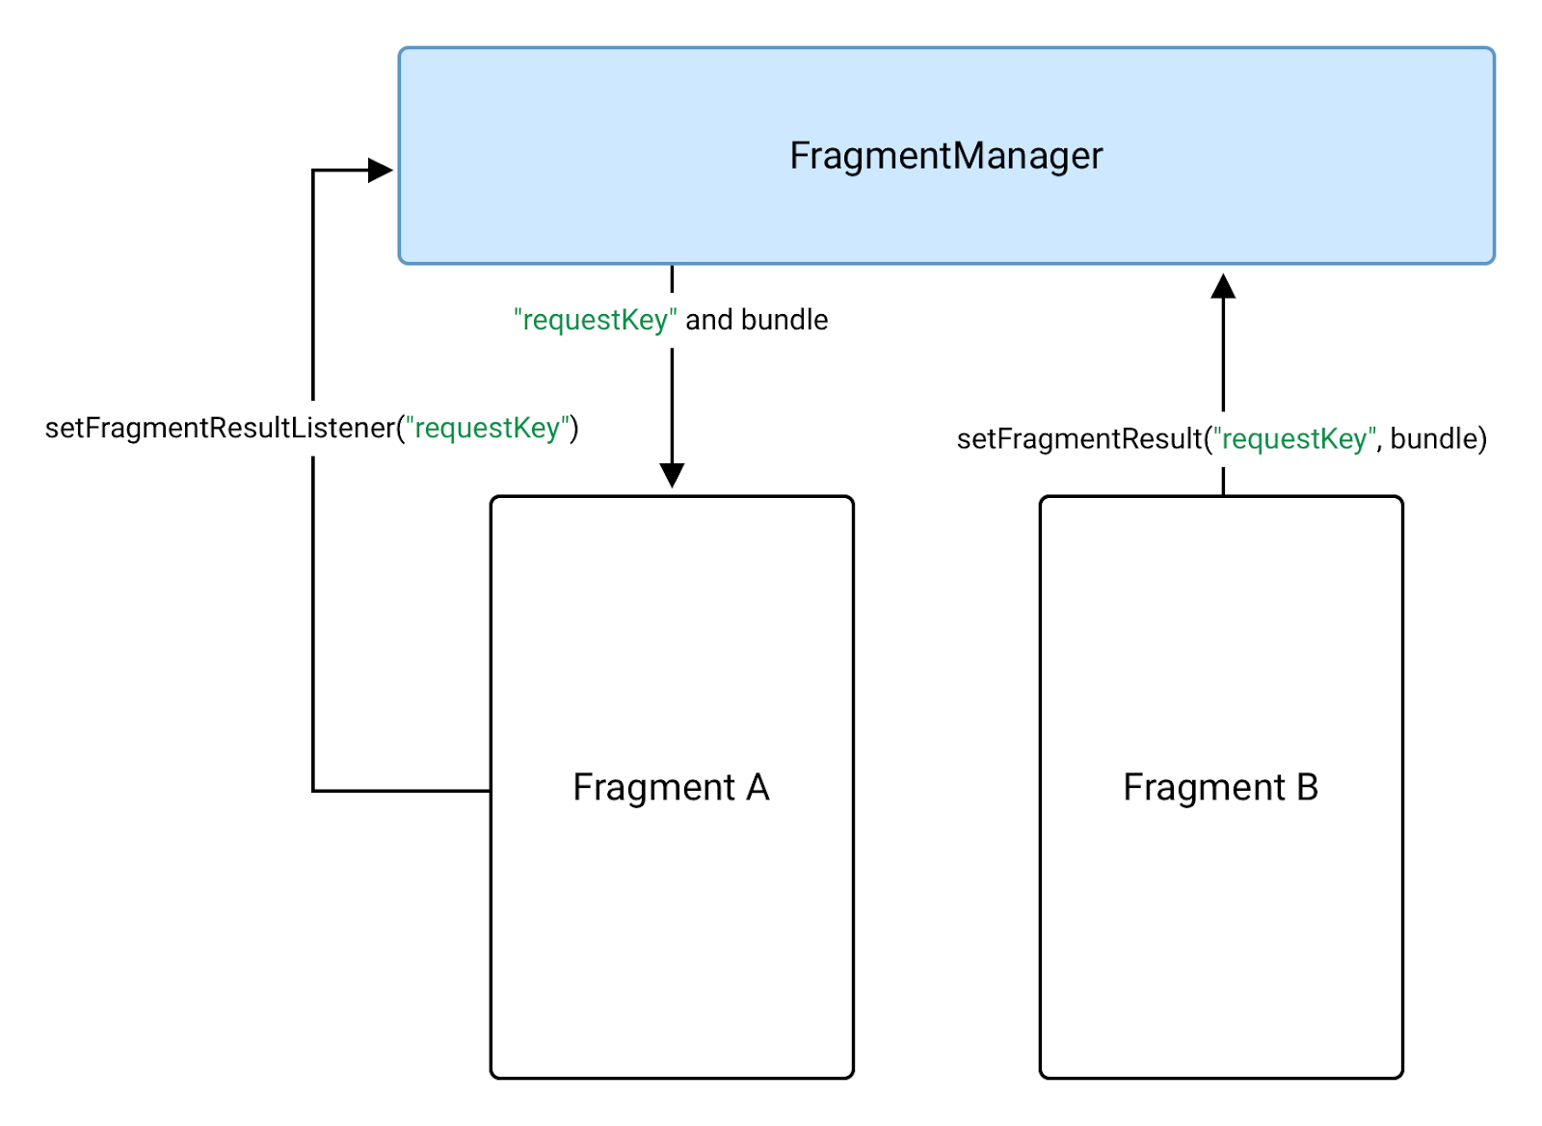
Fragment Result
You can pass information between fragments using FragmentResult.
It’s a storage for fragments where multiple fragments can use a key to store specific datas.

Slide 41
Extras

Slide 42
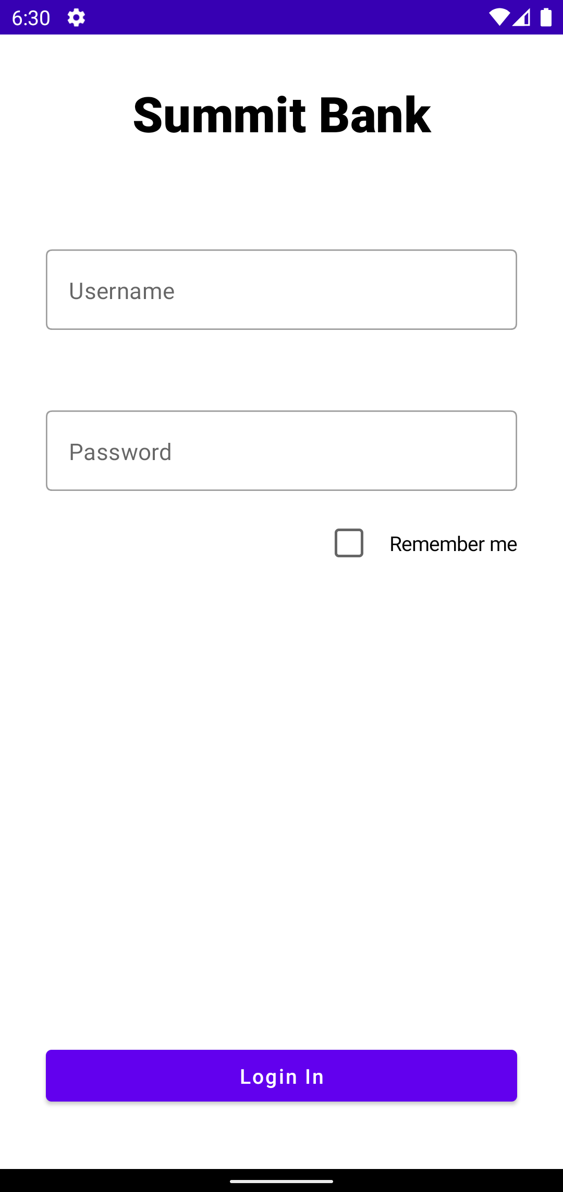
Extra features!
Let’s add on a “Remember Me” feature to remember user credentials.
And also an ability to select each individual transactions.

Slide 43
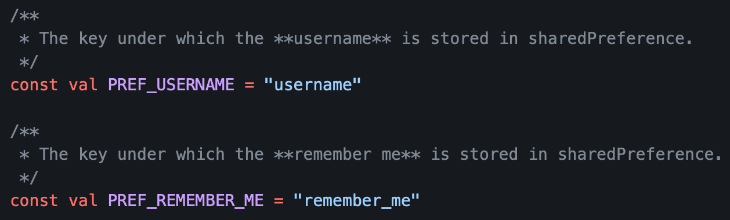
Simple data storage
You can use “SharedPreferences” to store simple key-value pairs to the app’s private storage.

Slide 44
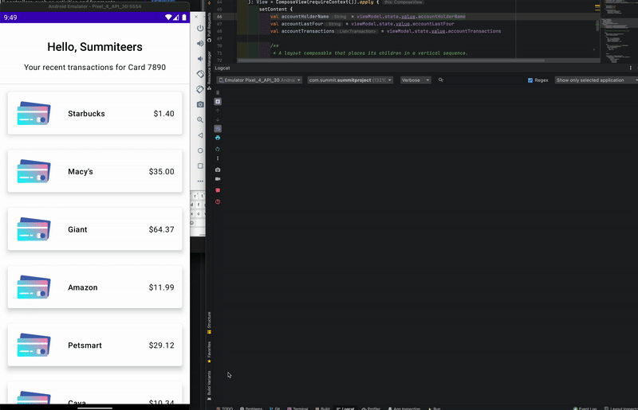
Reacting to list interactions
Let’s also add a simple behavior when the user taps on a transaction.

Slide 45
Wrapping Up

Slide 46
What did we build?
A simple app that allows the user to login & view a list of recent transactions:
Two screens
UI with Jetpack Compose
Basic networking and data storage

Slide 47
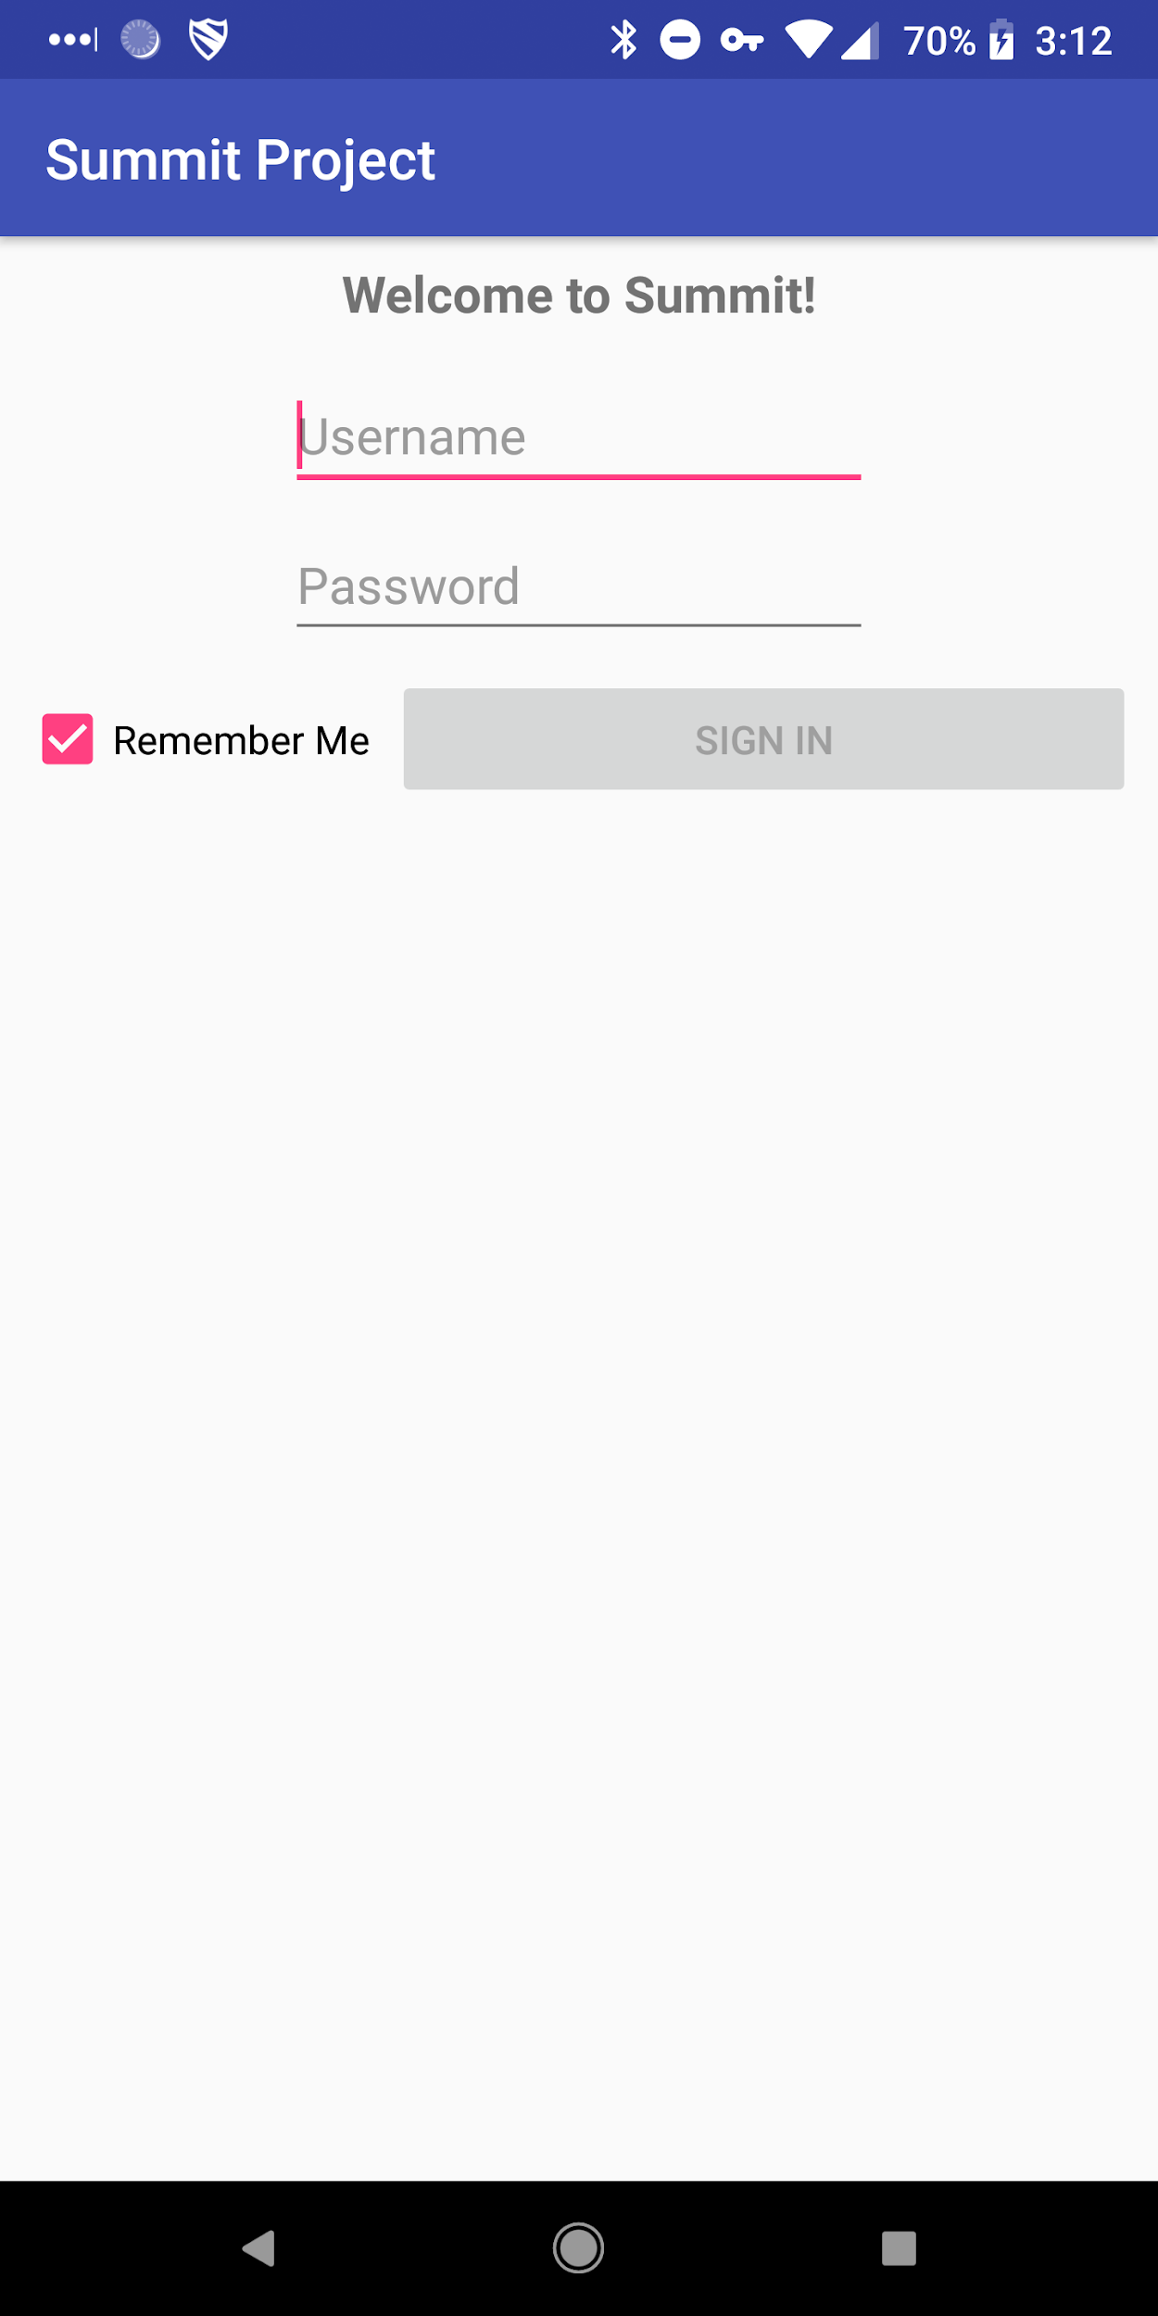
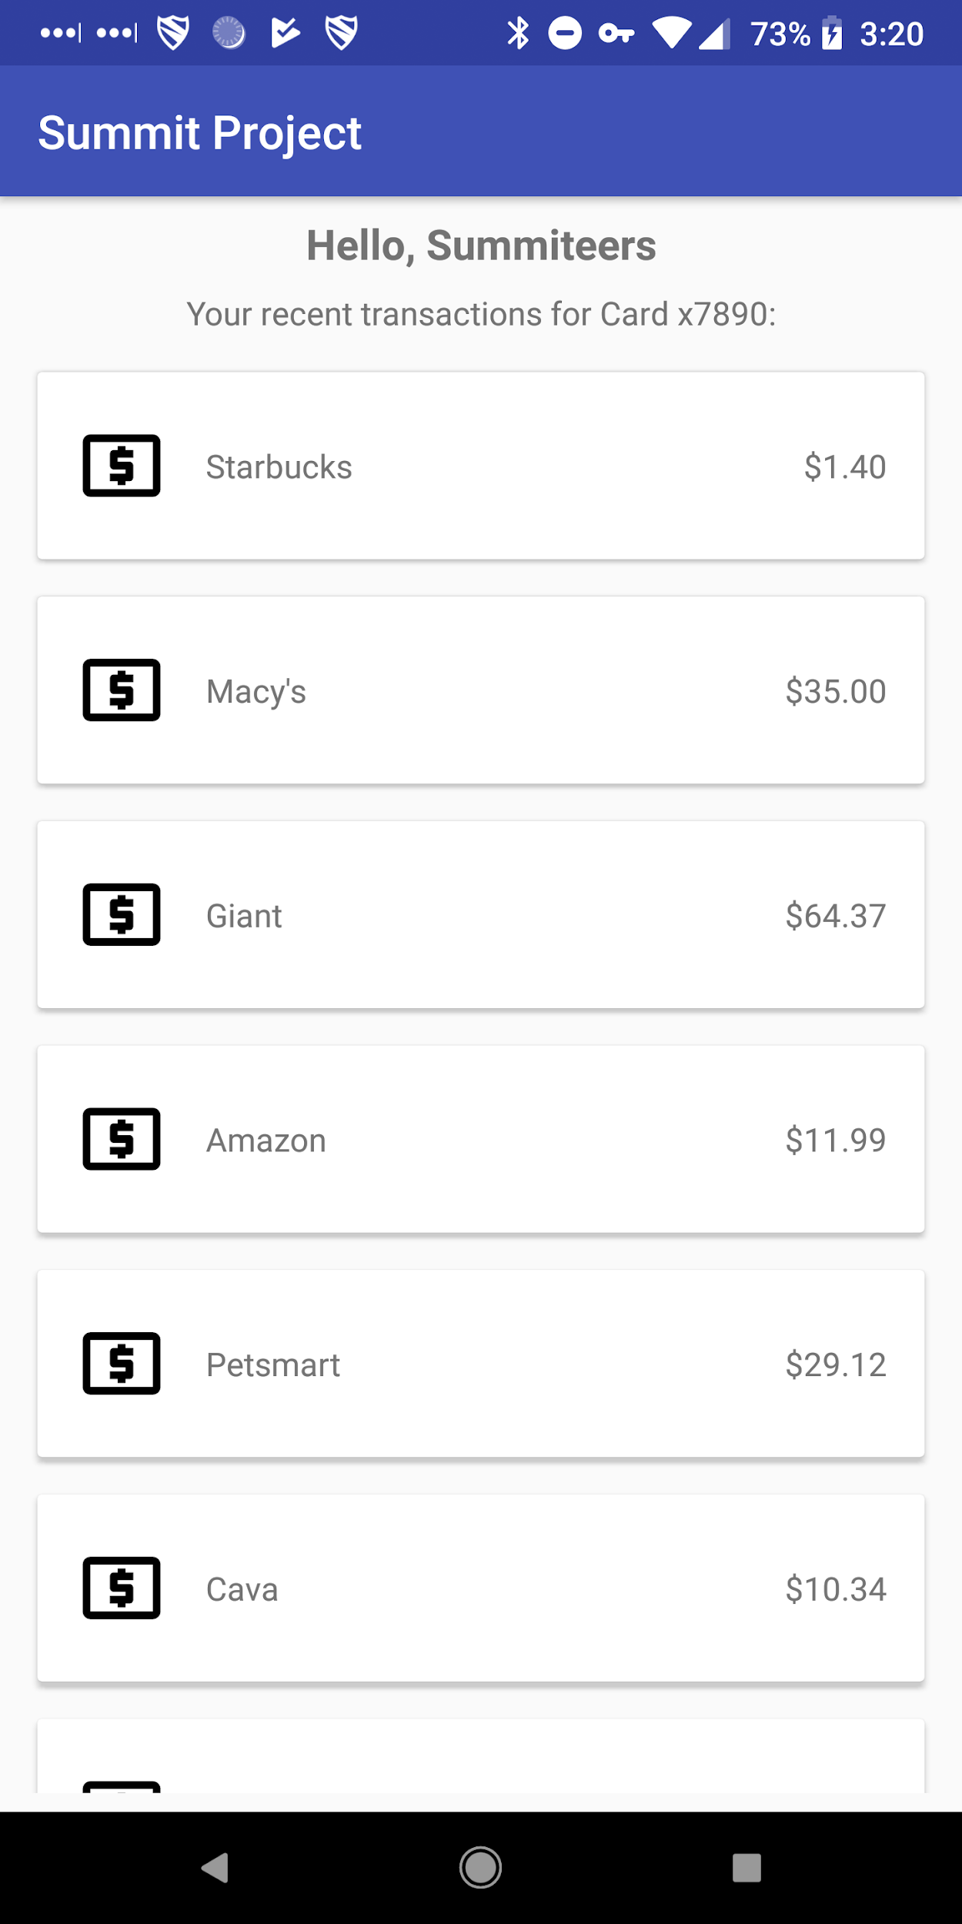
What did we build?
If you want the completed project with comments, checkout the “Completed” or “Extra” folder.

Slide 48


Android at Capital One
Over 200 Android (and iOS) devs work on the main Capital One Mobile app alone!
There are other apps built in-house too - like our CreditWise app.
A few devs have Flutter side-projects. Our conference app and website for the Android Summit conference is built in Flutter.

Slide 49
Want to continue learning Android?
Start learning modern Android using Google Codelabs
Android Kotlin Fundamentals
Check out this article in the C1 Tech Blog about helpful resources for learning Android
The Most Helpful Resources From My First Year in Android

Slide 50
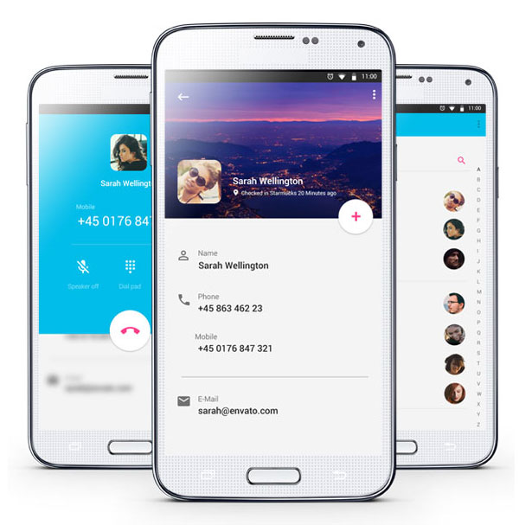
Other Resources
“I want a nicer UI”
https://developer.android.com/guide/topics/ui/look-and-feel
https://material.io/develop/android

Slide 51
Other Resources
“I want to learn more about networking”
Basics: https://developer.android.com/training/basics/network-ops/connecting
Popular libraries for making network calls: http://square.github.io/okhttp/ https://square.github.io/retrofit/
Threading: https://developer.android.com/guide/components/processes-and-threads
JSON parsing: https://www.tutorialspoint.com/android/android_json_parser.htm

Slide 52
Other Resources
“I want to interface with an API”
Capital One’s Hackathon API (Nessie) http://api.reimaginebanking.com/
“Host Your Own” Fake API: https://www.mocky.io/

Slide 53
Other Resources
“I want to use some hardware features”
Camera: https://developer.android.com/guide/topics/media/camera
Sensors: https://developer.android.com/guide/topics/sensors/sensors_overview
Bluetooth: https://developer.android.com/guide/topics/connectivity/bluetooth
NFC: https://developer.android.com/guide/topics/connectivity/nfc/

Slide 54
Other Resources
“I want a backend for user credentials and data”
Firebase Authentication (free): https://firebase.google.com/docs/auth/
Firebase Realtime DB (also free): https://firebase.google.com/docs/database/

Slide 55
Thanks for attending!
Find us on Slack and LinkedIn:
Slack: @yashar
https://www.linkedin.com/in/yaxarat/
Slack: @nickcapurso
https://www.linkedin.com/in/nickcapurso

